Slide 1
Pathways
2020-21 1st round D93 Club Officer Training

Slide 2


Slide 3
How many Paths?

Slide 4
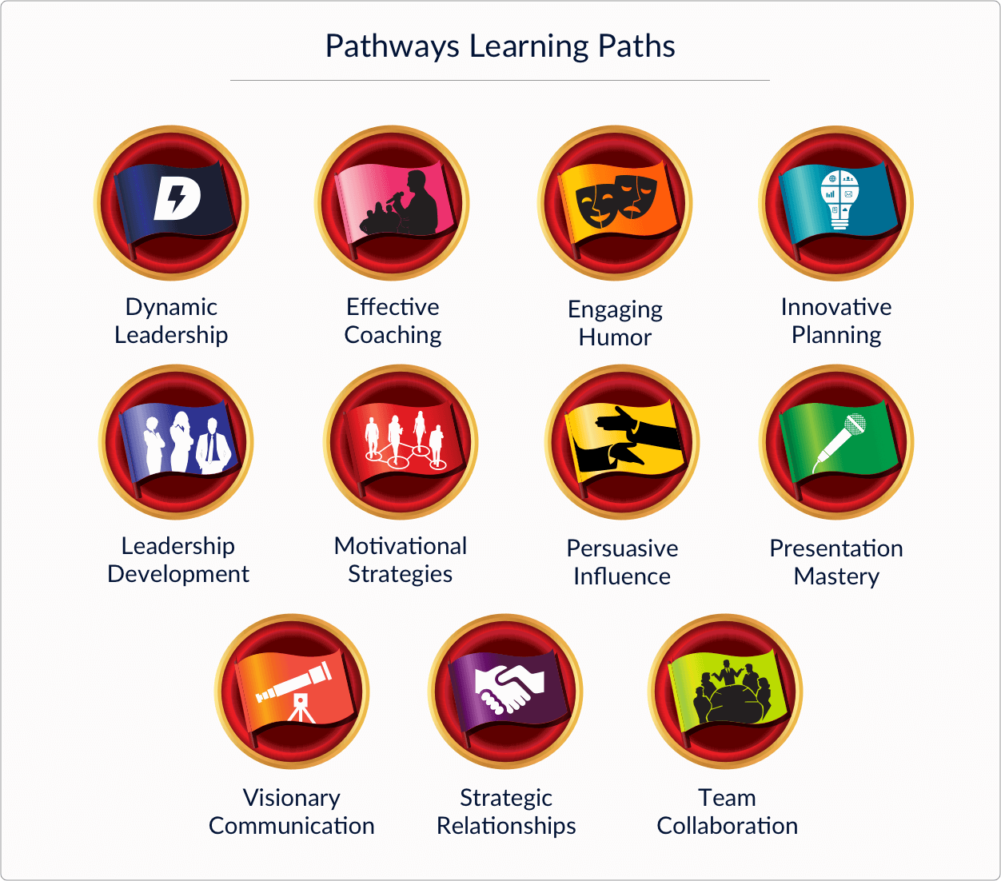

Slide 5
How many Korean Paths?

Slide 6
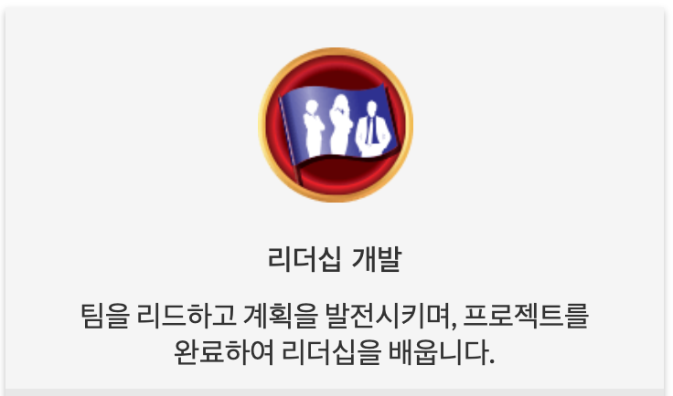
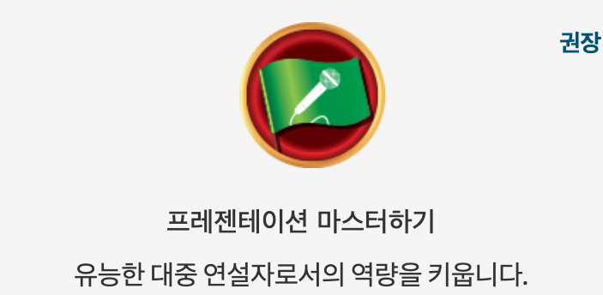
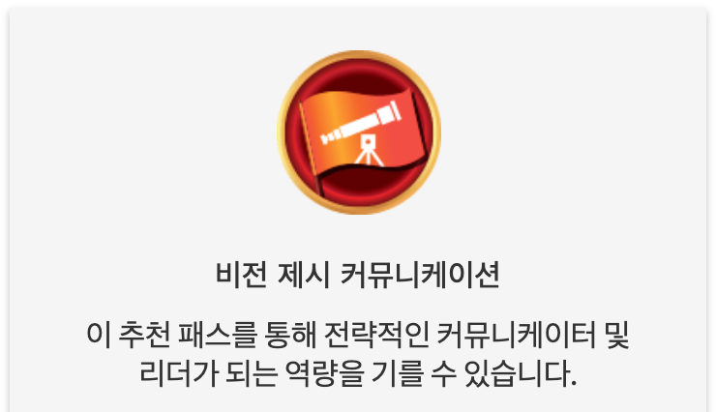
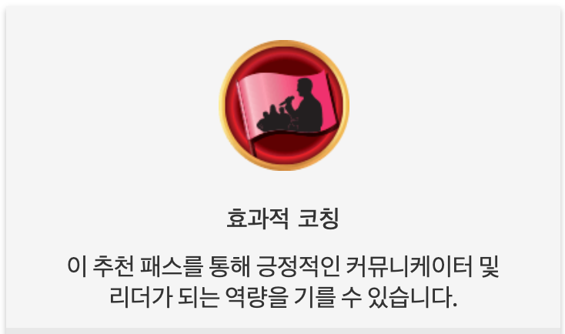
4 Korean Translated Paths

Slide 7
Paths and Structure
Source: George Marshall, DTM, D57
gdmarshall@gmail.com

Slide 8
How many levels in one path?

Slide 9
How many projects in one path?

Slide 10
Path Structure
The required projects define each path!
Level |  | Required Projects |  | Elective Projects
Level 5 |  | 2 |  | 1
Level 4 |  | 1 |  | 1
Level 3 |  | 1 |  | 2
Level 2 |  | 3 |  | 0
Level 1 |  | 3 |  | 0
14 Projects

Slide 11
Path Structure
Level |  | Required Projects |  | Elective Projects |  | Challenge & Complexity
Level 5 |  | 2 |  | 1
Level 4 |  | 1 |  | 1
Level 3 |  | 1 |  | 2
Level 2 |  | 3 |  | 0
Level 1 |  | 3 |  | 0

Slide 12
Path Structure
Level |  | Required Projects |  | Elective Projects
Level 5 |  | 2 |  | 1
Level 4 |  | 1 |  | 1
Level 3 |  | 1 |  | 2
Level 2 |  | 3 |  | 0
Level 1 |  | 3 |  | 0
Communication
& Leadership
Mostly
Communication

Slide 13
Paths by Focus

Slide 14
Path by Focus
Public Speaking Focus
Group 1
Group 2
Group 3
Group 4
Leadership Focus

Slide 15
Path by Focus
Group 1 - Public Speaking
Presentation Mastery
Engaging Humor
Group 2 - Public Speaking + Leadership (Basic)
Leadership Development
Motivational Strategies
Visionary Communication
Korean
Korean
Korean
Group 3 - Public Speaking + Leadership (Moderate)
Dynamic Leadership
Strategic Relationships
Team Collaboration
Group 4 - Public Speaking + Leadership (Substantial)
Effective Coaching
Innovative Planning
Persuasive Influence
Korean

Slide 16
Group 1 - Public Speaking
Required Project
All speeches!!
Level 5 Projects
Longer Speeches (18-22 minutes)
Paths
Presentation Mastery
Engaging Humor
Leadership projects available as electives

Slide 17
Group 2 - Public Speaking + Leadership (Basic)
Required Project
Plan or Do modest projects, Speak about it
Level 5 projects
Plan & possibly complete a modest project
Paths
Leadership Development
Motivational Strategies
Visionary Communication

Slide 18
Group 3 - Public Speaking + Leadership (Moderate)
Required Project
Create & Develop Plans with a Team
Level 5 projects
Serve at least six months in a Leadership role
Club officer, committee chair, at-work project …
Paths
Dynamic Leadership
Strategic Relationships
Team Collaboration

Slide 19
Group 4 - Public Speaking + Leadership (Substantial)
Required Project
Create & Develop Plans with a Team: Broader than Group 3
Level 5 projects
High-Performance Leadership Project (HPL)
Requires Guidance Committee, Action Team
Paths
Effective Coaching
Innovative Planning
Persuasive Influence

Slide 20
Path by Focus
Group 1 - Public Speaking
Presentation Mastery
Engaging Humor
Group 2 - Public Speaking + Leadership (Basic)
Leadership Development
Motivational Strategies
Visionary Communication
Korean
Korean
Korean
Group 3 - Public Speaking + Leadership (Moderate)
Dynamic Leadership
Strategic Relationships
Team Collaboration
Group 4 - Public Speaking + Leadership (Substantial)
Effective Coaching
Innovative Planning
Persuasive Influence
Korean

Slide 21

Pathways Mentoring Program
Level 2 Project
Introduction to Toastmasters Mentoring
Complete 3 Projects
Level 3: Prepare to Mentor
Level 4: Mentoring
Level 5: Advanced Mentoring
To be a Pathways Mentor
Completion of any Path + Mentoring Program

Slide 22
Pathways Mentoring Program (Project in detail)
Level 3: Prepare to Mentor
Basic information to work as mentor / self-assessment
Level 4: Mentoring
Guided manual for short term Mentoring
Mentoring your protégé for short term
Protégé: Toastmasters
Level 5: Advanced Mentoring
Mentoring your protégé for 6 months
Protégé: Toastmasters or outside of Toastmasters

Slide 23
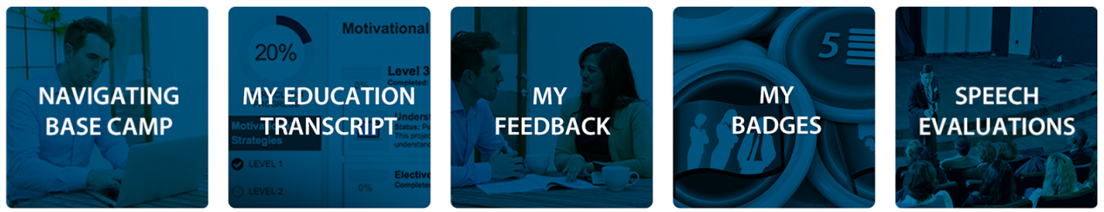






Pathways DTM Journey
Club Officer-12 months
District Officer
Club Mentor or Club Coach
Club Sponsor or Speechcraft
or Youth Leadership Program
New Member
DTM PROJECT
DTM

Slide 24
Completing a Project

Slide 25
Member Completing Projects
Re-open Project
Complete Assess Skills-After
No Approval Needed

Slide 26
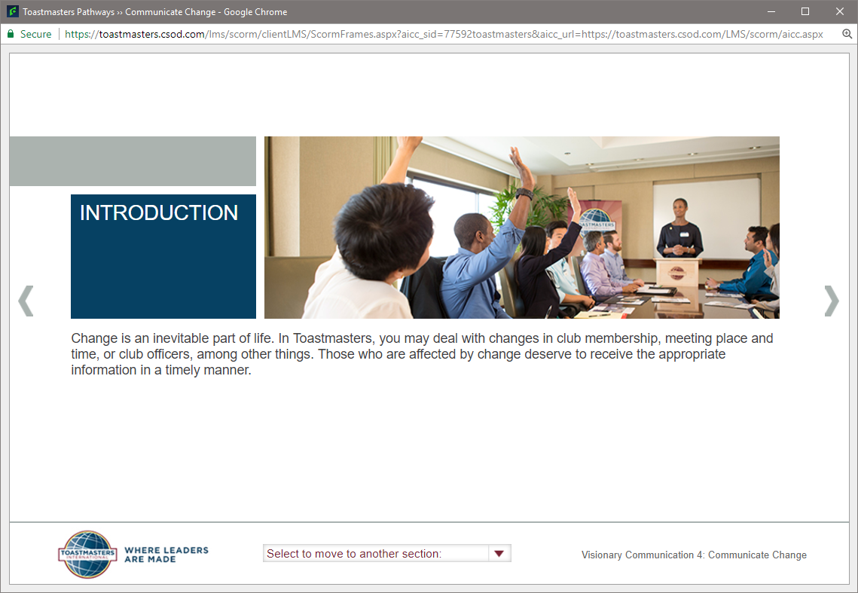
Member Completing Projects
1. Re-open the Project

Slide 27
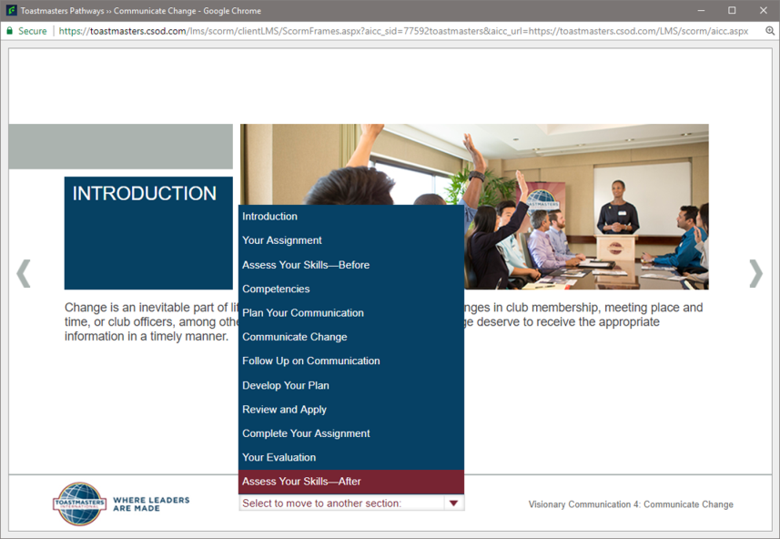
Member Completing Projects
2. Go to Assess Skills-After

Slide 28
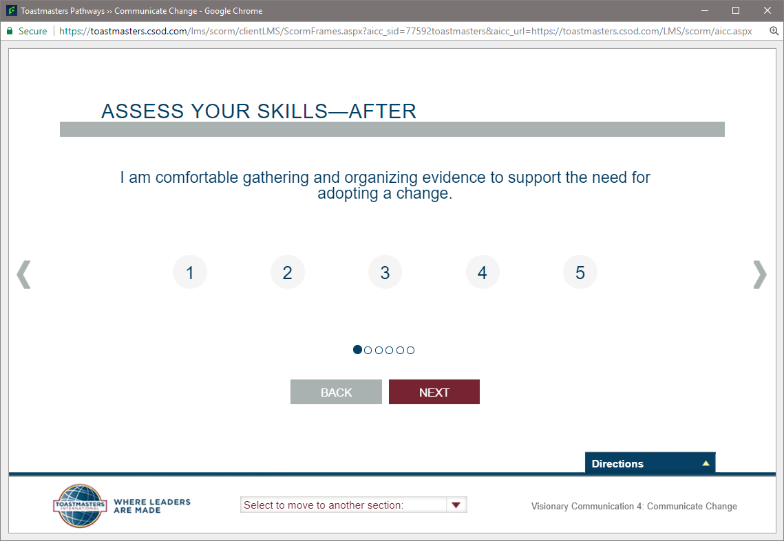
Member Completing Projects
3. Complete Assess Skills-After

Slide 29
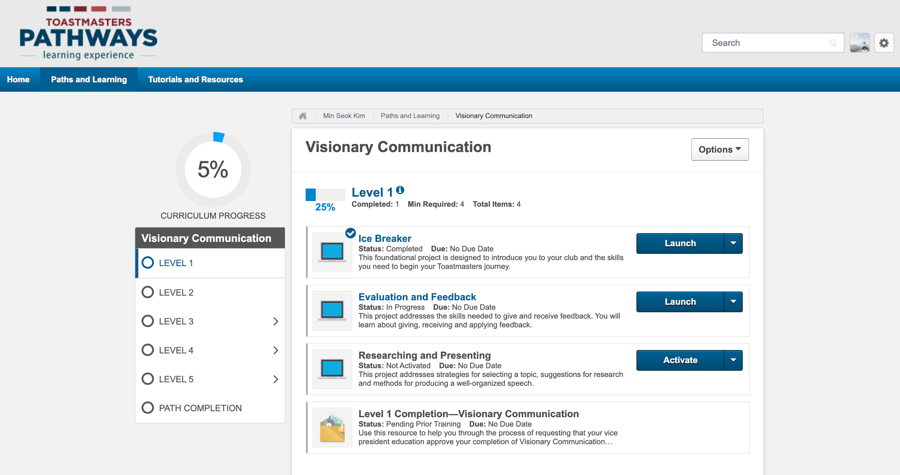
Member Completing Projects
No Approval Needed!

Slide 30
Completing a Level

Slide 31
Member Completing Levels
Run the “Level Completion” task
Open Curriculum
Activate - Launch
Mark Complete
Notify your VPE & Base Camp Managers

Slide 32
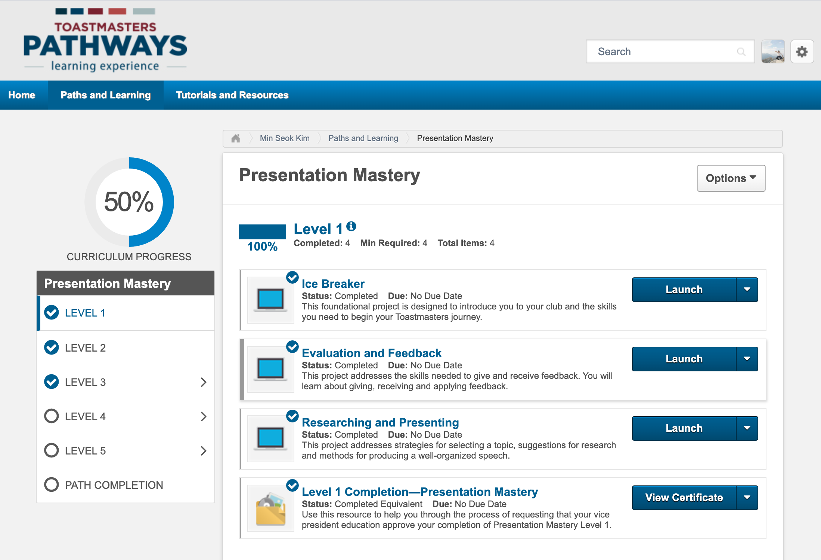
Member Completing Levels
1. Run the “Level Completion” task
- Open Curriculum
- Activate - Launch
- Mark Complete

Slide 33
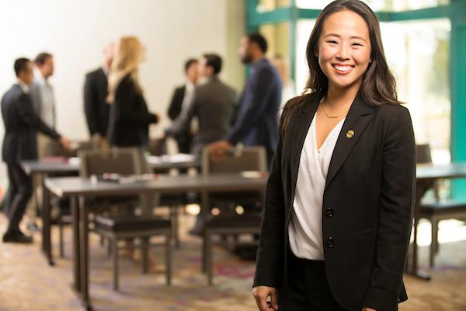

Member Completing Levels
2. Notify VPE
& Base Camp Manager
(VPE, President
or Secretary)
If you are a member of more than one club!

Slide 34
Base Camp Manager Approving Levels & Awards
Base Camp Manager: VPE, Pres or Secretary
Log in as Base Camp Manager
Mark the member’s level as Approved
VPE (or Any Officer)
Submit Level award in Club Central

Slide 35
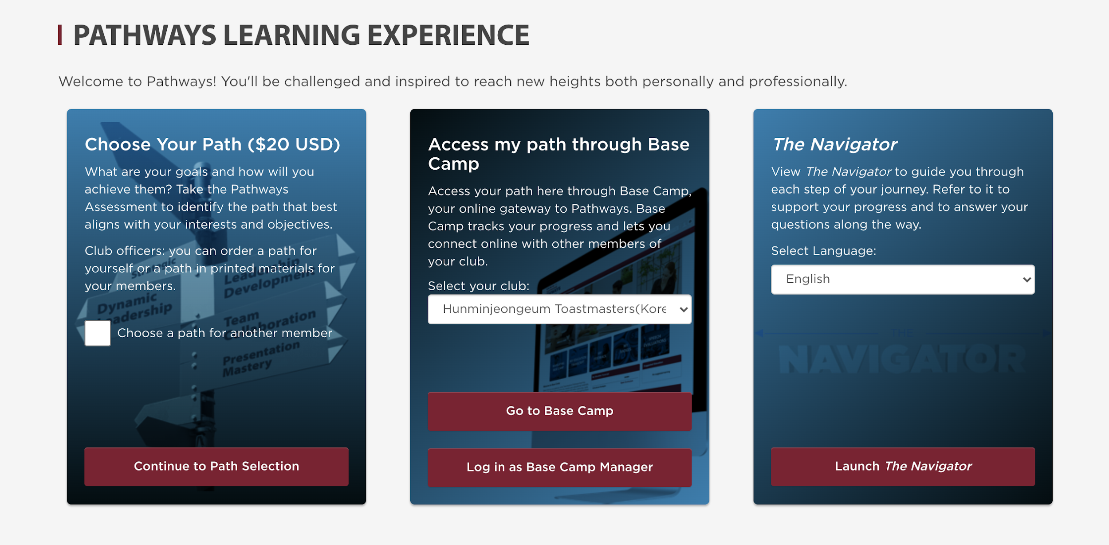
Base Camp Manager (From Pathways menu)
1. Log in as
Base Camp Manager

Slide 36
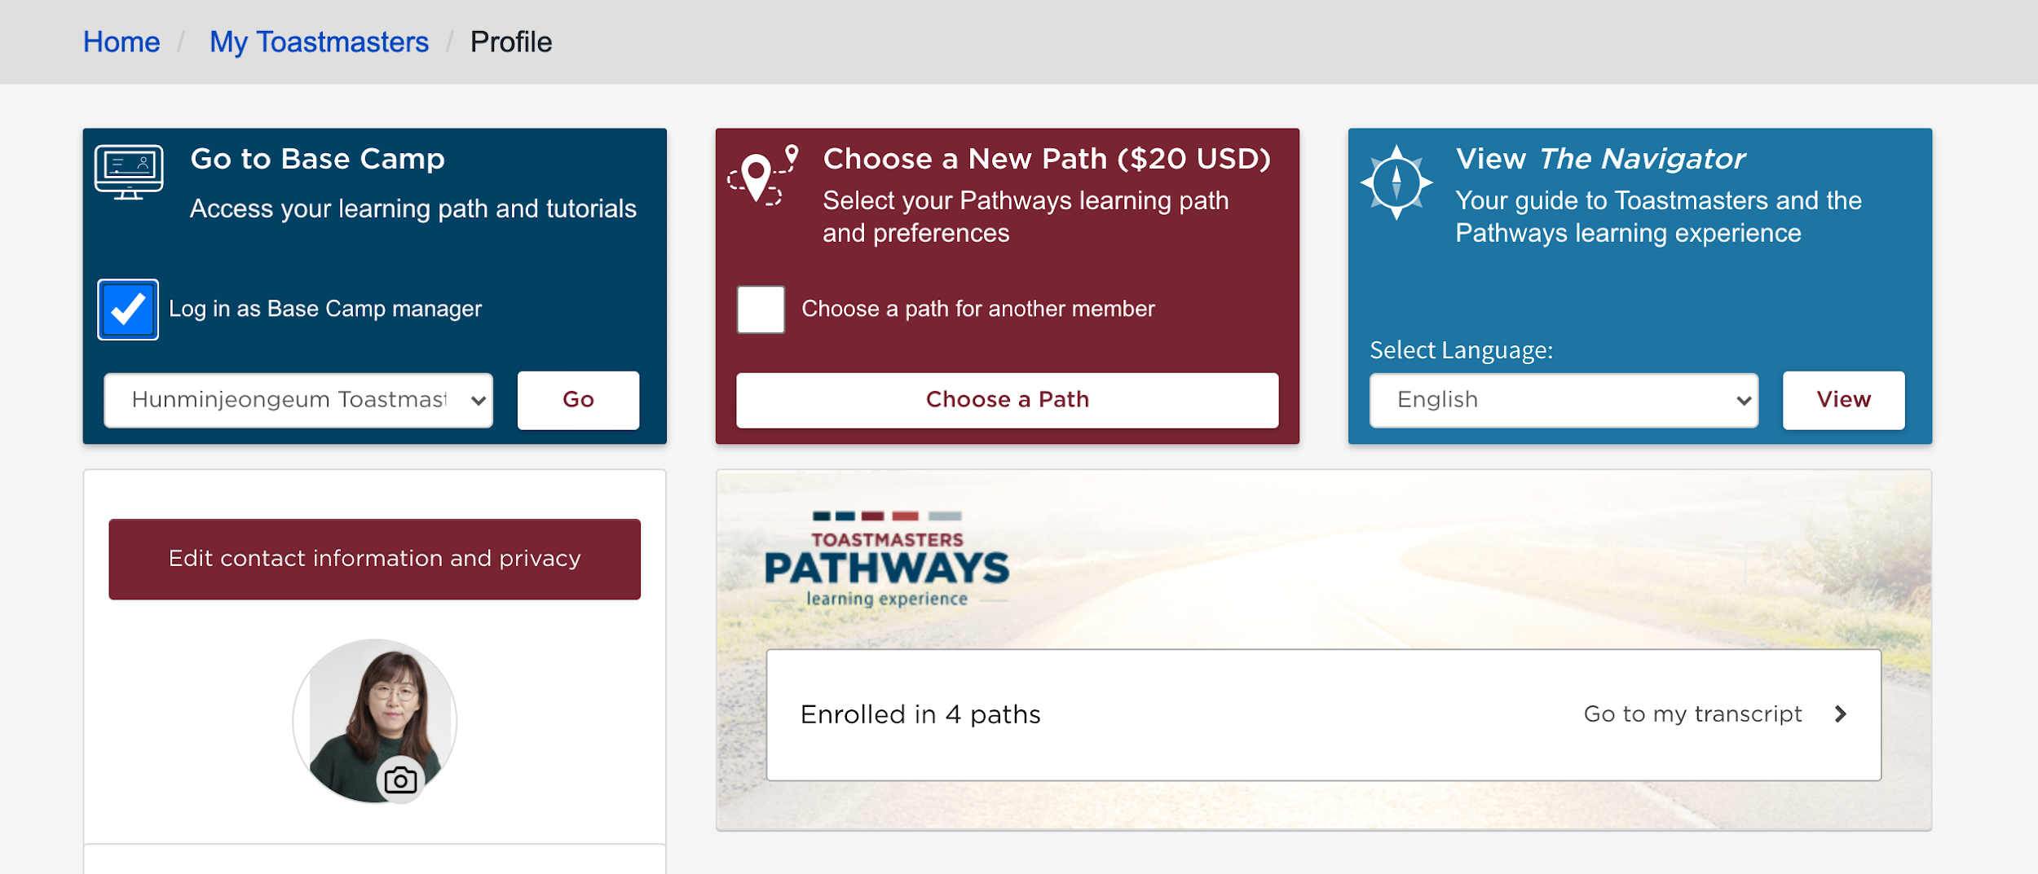
Base Camp Manager (From Profile menu)
1. Log in as
Base Camp Manager

Slide 37
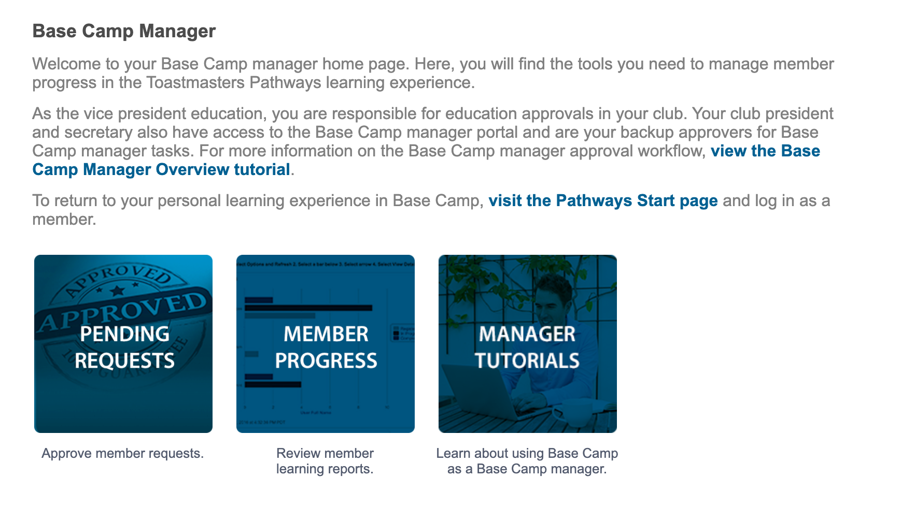
Base Camp Manager
2. Go to Pending Requests

Slide 38
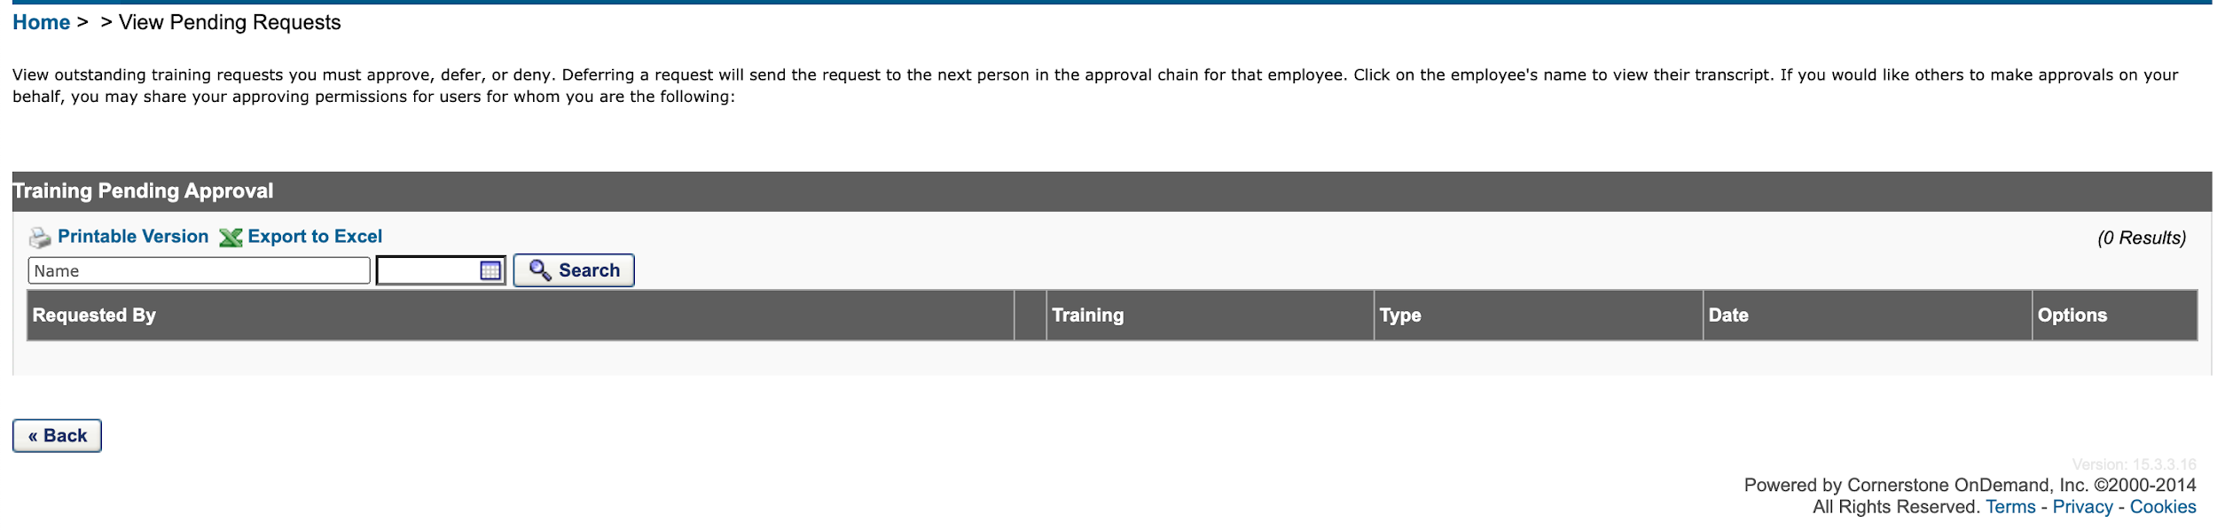
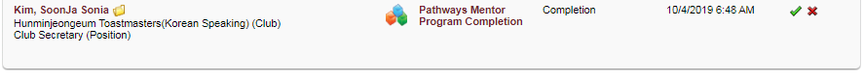
Base Camp Manager
3. Mark the members level as Approved
Member Name
Club Name
Path Title & Level Number
✔

Slide 39
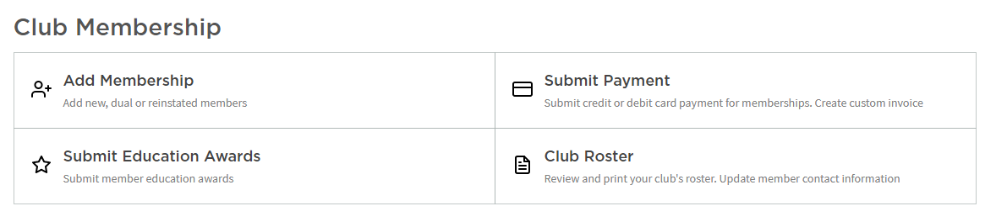
VPE (or Any Officer)
Submit the member’s level at Club Central

Slide 40
Badges & Certificates

Slide 41





Badges

Slide 42
Certificates
View Certificate

Slide 43
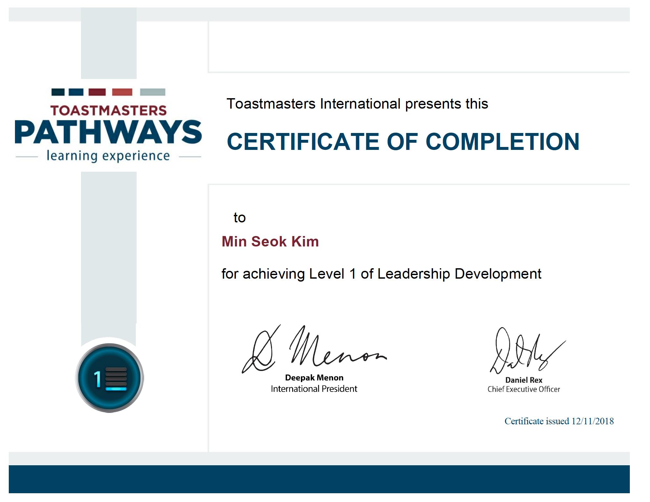
Certificates
Print & Present

Slide 44







FAQ
Pathways FAQ
https://www.toastmasters.org/education/pathways/frequently-asked-questions
Toastmasters International(TI) Video about Pathways
https://www.youtube.com/c/toastmasters/videos

Slide 45
Who are the Base Camp managers?
Notes:
VPE mainly
President, Secretary

Slide 46
Is Pathways available in printed format?
Notes:
Presentation Mastery
Leadership Development
Strategic Relationships (English only)
Dynamic Leadership (English only)
Team Collaboration (English only)

Slide 47
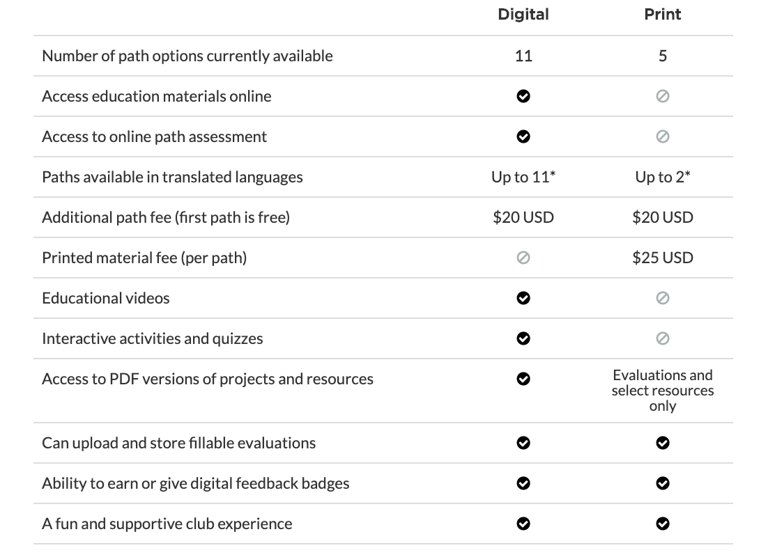
Digital vs. Print
Limited Option
No Video resource
Additional printing fee
Additional delivery fee!!!

Slide 48
Korean Path
한국어 없음!
2개 패스 예정

Slide 49
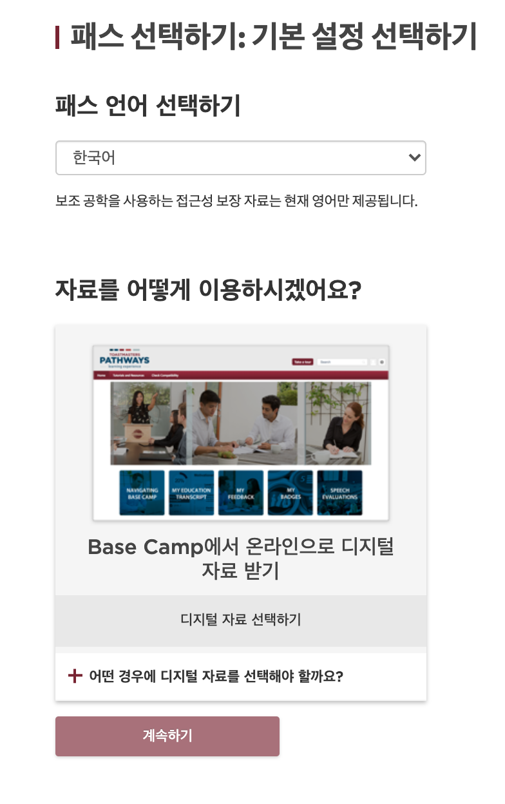
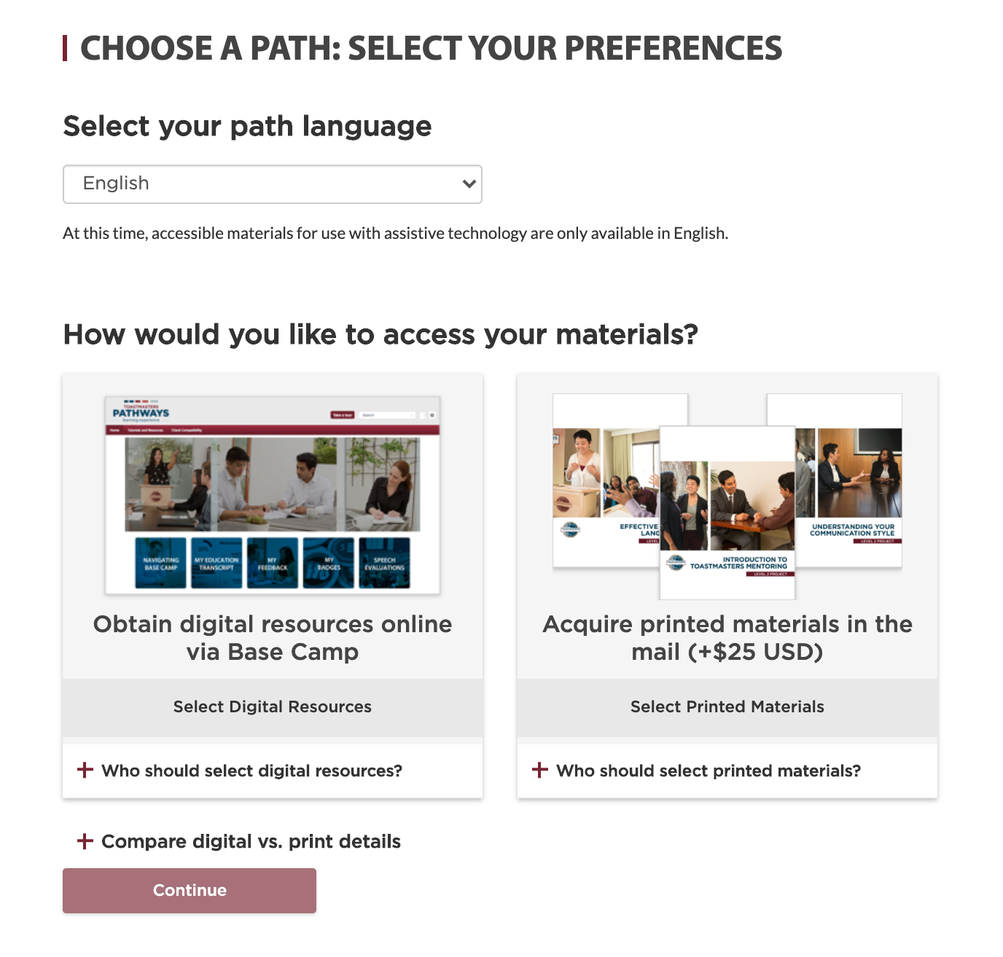
Korean Path

Slide 50
Can I complete projects and levels
in any order I choose?
Notes:
Projects in Pathways build in complexity across levels. The levels in each path are designed to be completed sequentially. For example, you may learn about organizing a small event in Level 4 of your path. At Level 5, you may then work on a developing and implementing a larger event. The sequential order, time to complete projects, and opportunity to apply what you learn throughout your path, is by design.
Should you decide that it is appropriate for you as a learner, you may complete levels and projects in the order of your choice.

